Slide 1
Handling class imbalance by GAN based Data Augmentation in Medical Images
Amitkumar M Maheshwari
Research Presentation Master of Science in Machine Learning and Artificial Intelligence

Slide 2
Background

Slide 3
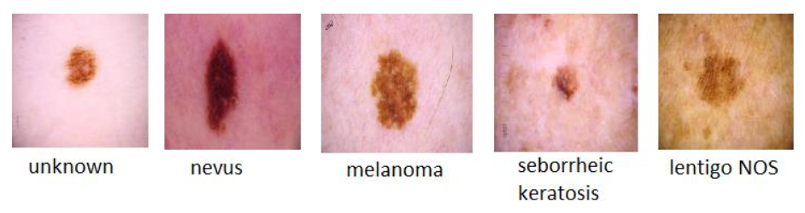
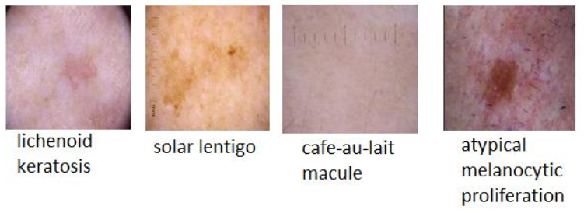
Skin Cancer Lesions
In ISIC 2020 Dataset

Slide 4
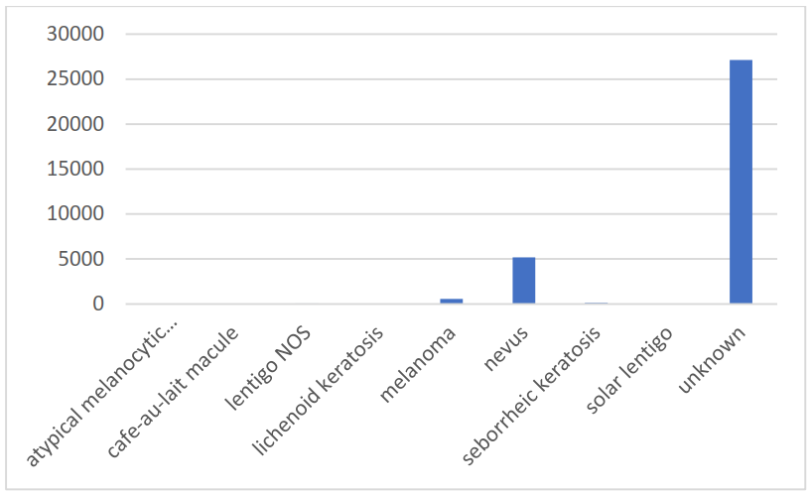
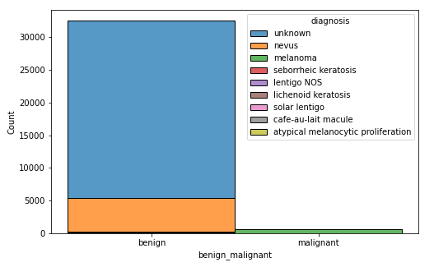
Skin Cancer Lesions
Class distribution

Slide 5
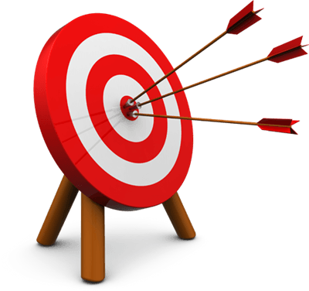
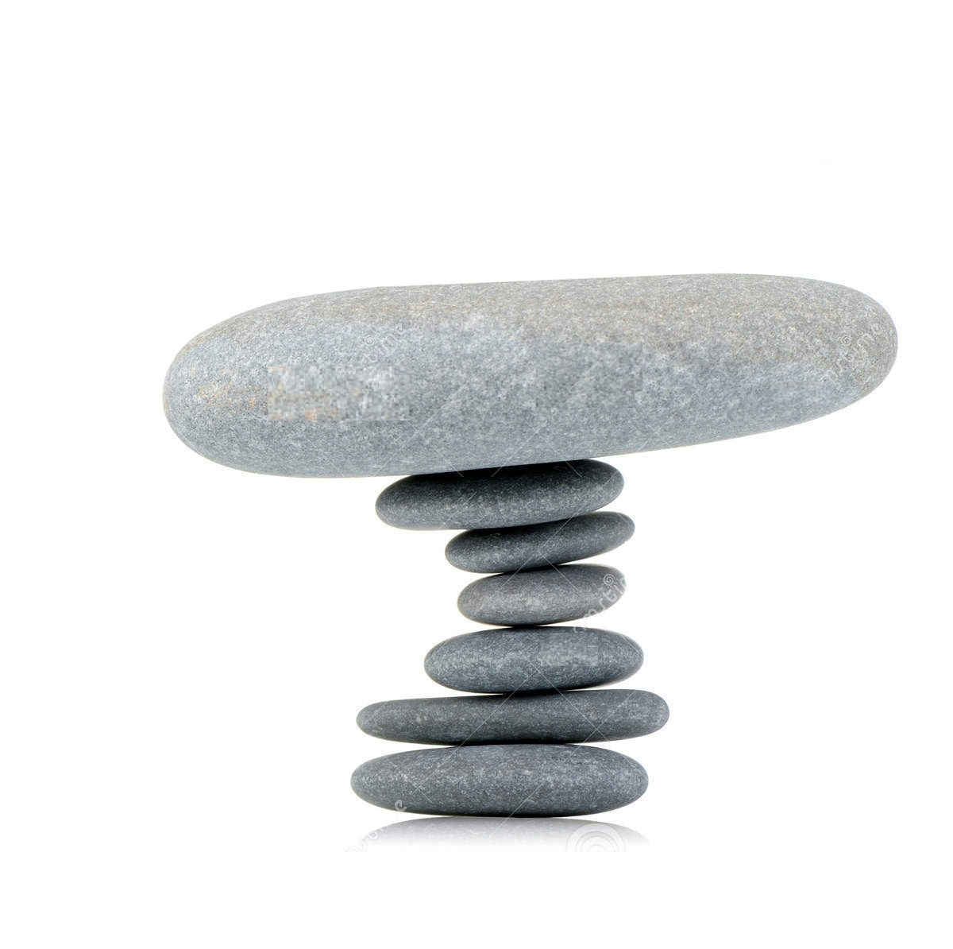
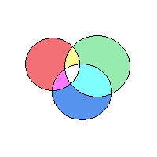

Aim
Generative Model
Stable
Diverse
Efficient

Slide 6

Related Works
Normal GANs
Conditioned GANs
Progressive GANs
Style GANs

Slide 7
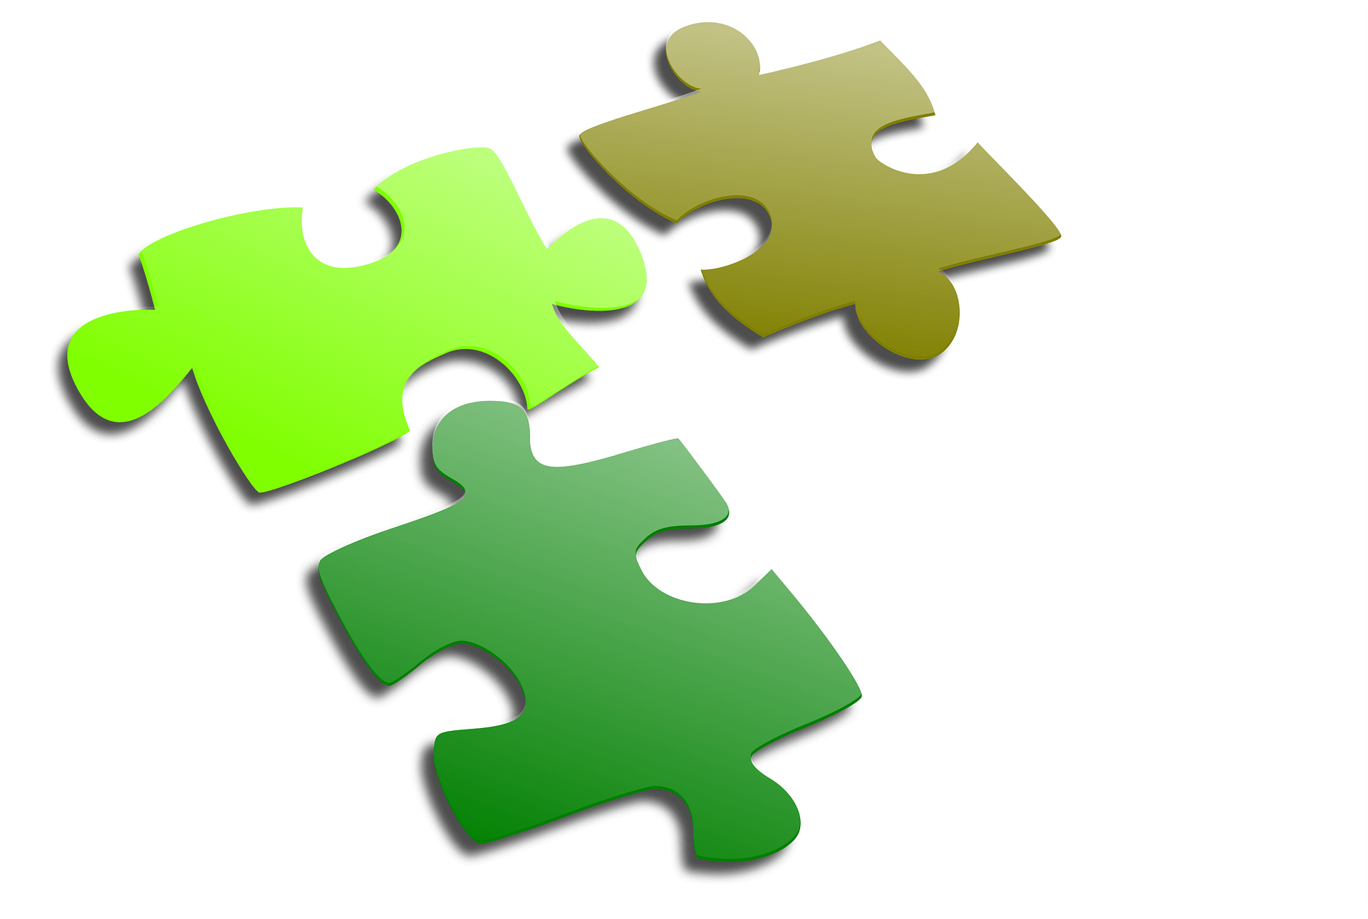
GAPs
Computationally Bulky and Time Consuming
Often Unstable for higher resolution
Generally Manual Evaluation is required
Works better on Radiographic images
Limited Exposer on Dermoscopic Images

Slide 8
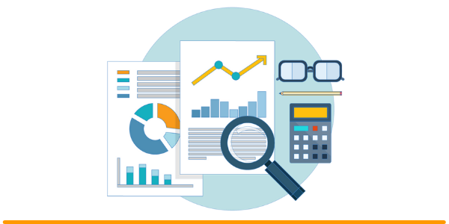
Methods
Autoencoder
Generative Adversarial Nets
Integration of AE with GAN

Slide 9
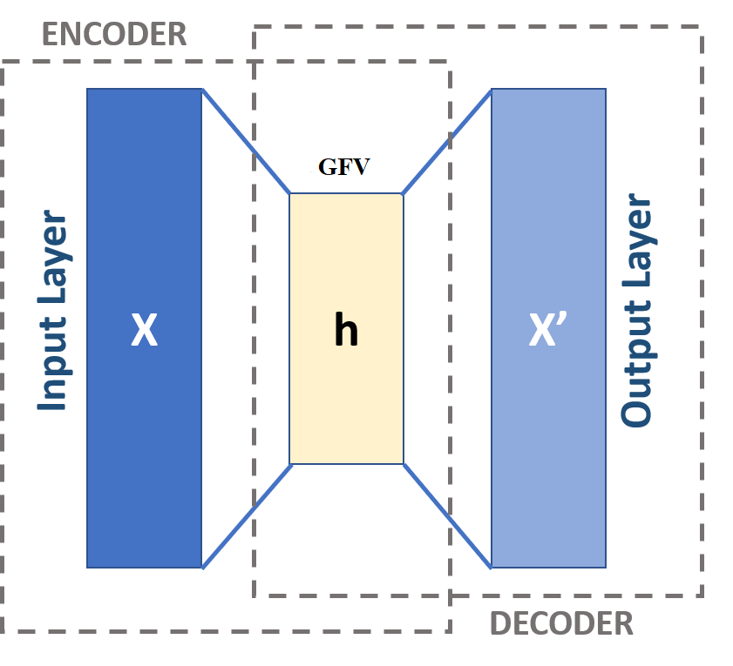
Autoencoder

Slide 10
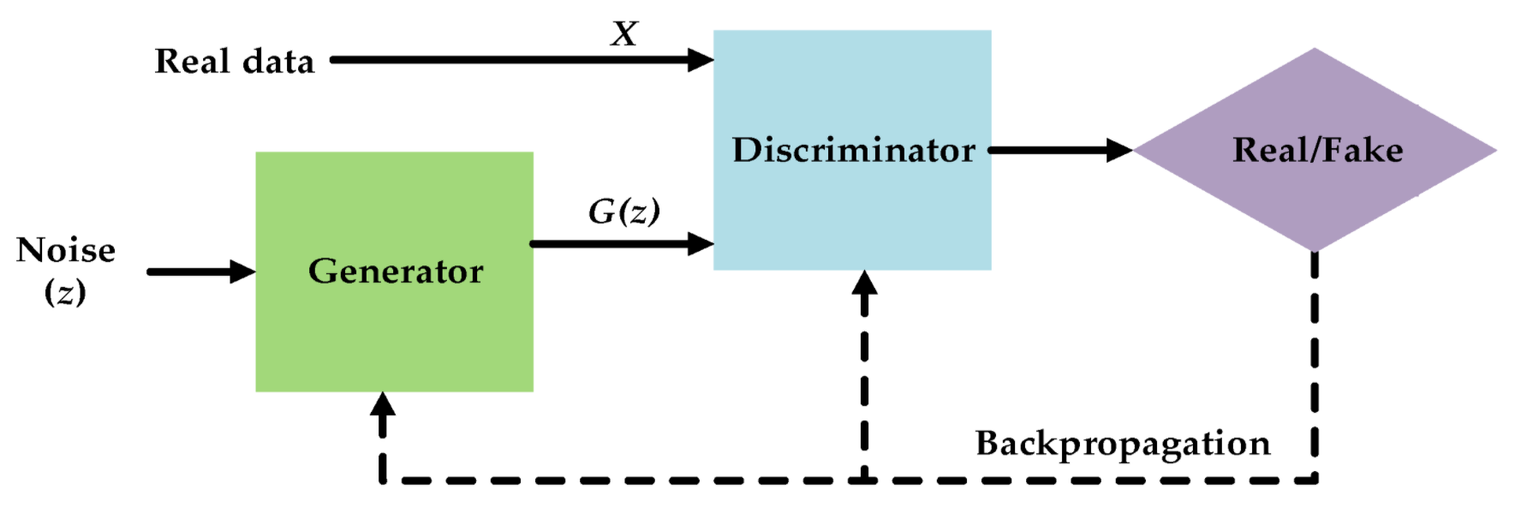
Generative adversarial nets

Slide 11
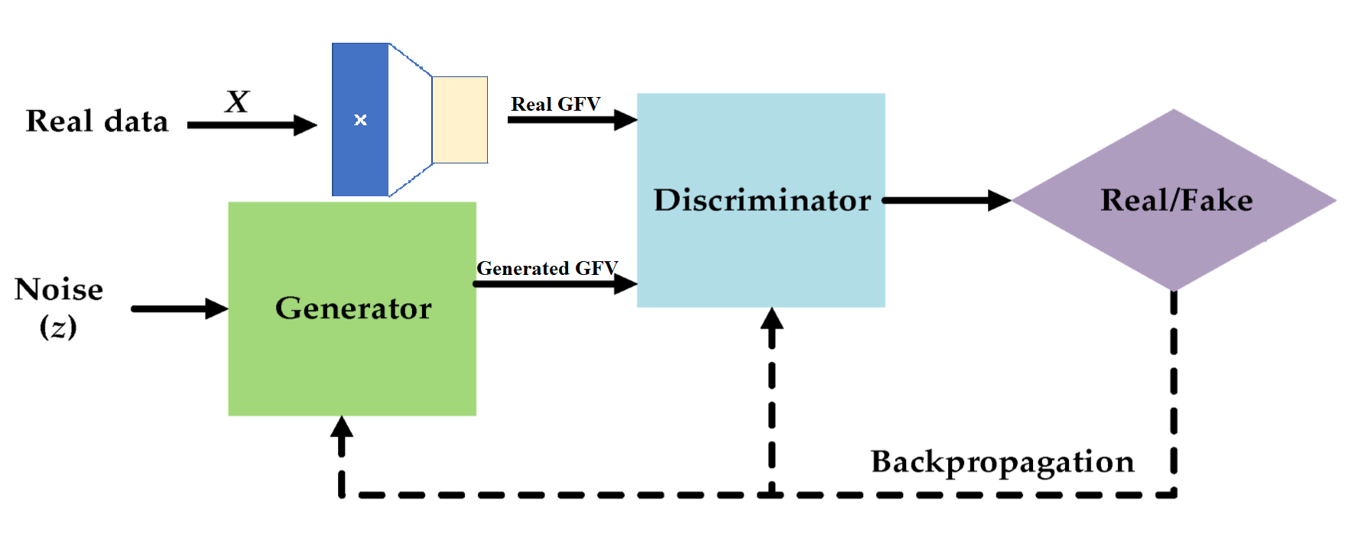
Integrated system of AE and GAN

Slide 12
Results
Image visualization
Computational Cost
Classification Performance

Slide 13
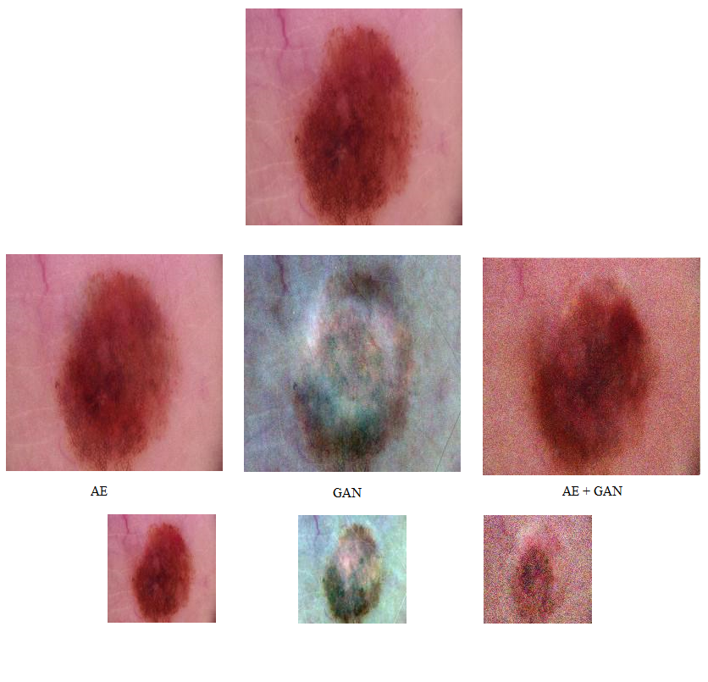
Generated Images

Slide 14
Inception Score
Case | Inception score
Two Identical Images | 1.0
AE Generated Image with Original Image | 1.45
GAN Generate Image with Original Image | 2.16
AE+GAN Generated Image with Original Image | 1.89
Two Totally Different Images | 2.60

Slide 15
Trainable Parameters
Model | Trainable parameters
Autoencoder(AE) | 855,994,368
Generative Adversarial Nets(GAN) | 607,285,633
GAN with AE | 15,683,546

Slide 16
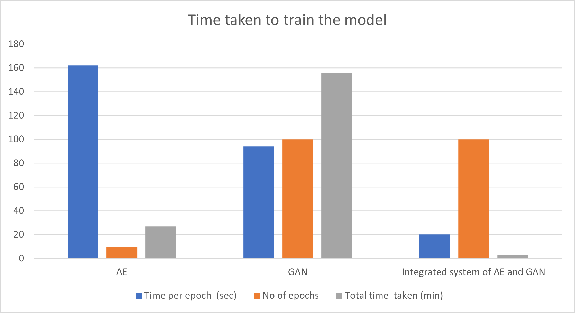
Training Time
Model | Training Time (minutes)
Autoencoder(AE) | 27
Generative Adversarial Nets(GAN) | 156
GAN with AE | 3.33

Slide 17
Classification Results
model trained using | Accuracy | Sensitivity
Untreated Dataset | Train: 0.94 Val: 0.88 | 0.084
Down sampling the dominant classes | Train: 0.87 Val: 0.75 | 0.33
Traditionally Transferred Images Augmented Dataset | Train: 0.86 Val: 0.77 | 0.48
GAN+AE Generated Images Augmented Dataset | Train: 0.91 Val: 0.82 | 0.57
Traditionally transferred with AE+GAN Generated Images Augmented Dataset | Train: 0.89 Val: 0.80 | 0.54

Slide 18
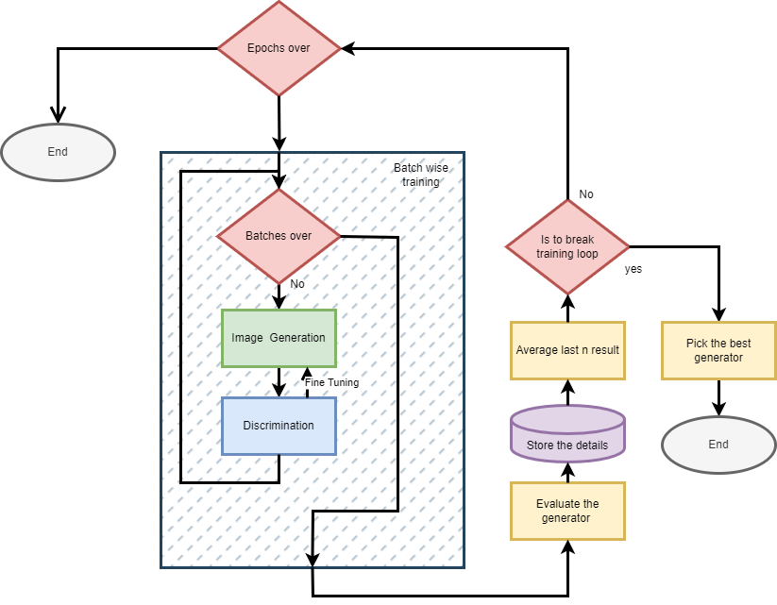
Loop Breaker

Slide 19
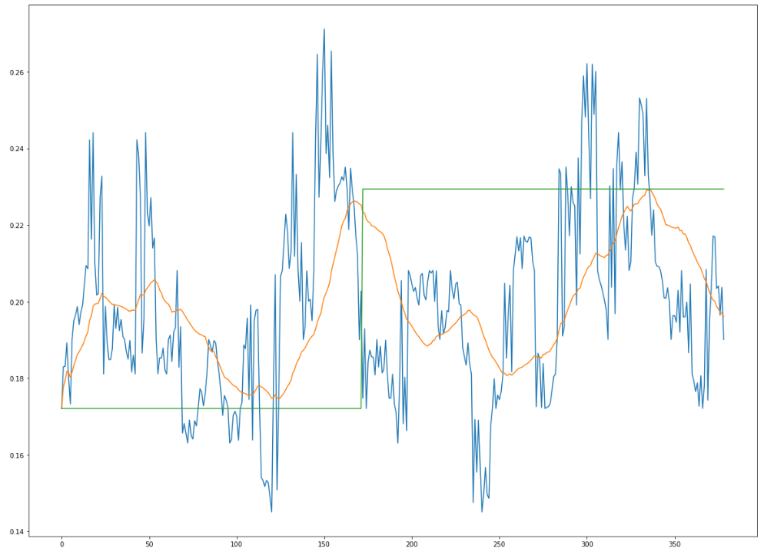
Loop Breaker

Slide 20

Conclusion
Sensitivity Improved by 72%
Balancing the dataset with AE+GAN generated images improves the sensitivity from 0.33 to 0.57
Time Consumption decreased by 78.8%
The integrated system of AE and GAN takes around 33 minutes to get trained in comparison with 156 minutes taken by conventional GAN

Slide 21
Future Recommendations
Reinforcement Learning
To
Enhance efficiency
and performance of GAN
Image Segmentation
With
Image to Image translation
Conditional GAN
To
Augment other classes

Slide 22
THANK YOU

